Slide 1
UNIT-4
XML and AJAX
PL/SQL: Declaring PL/SQL Variables, Writing Executable Statements, Using SQL Statements Within a PL/SQL XML Basics - Parser - DOM - XPath - XSL/XSLT - Xquery - DTD - Schema - Namespaces. AJAX Basics - Request and Response- AJAX using XML- AJAX using Java Script and JQuery.

Slide 2
Introduction
PL/SQL is a block structured language that can have multiple blocks in it.
The PL/SQL programming language was developed by Oracle Corporation in the late 1980s as procedural extension language for SQL and the Oracle relational database.
SQL stands for Structured Query Language i.e. used to perform operations on the records stored in database such as inserting records, updating records, deleting records, creating, modifying and dropping tables, views etc.
The programs of PL/SQL are logical blocks that can contain any number of nested sub-blocks

Slide 3
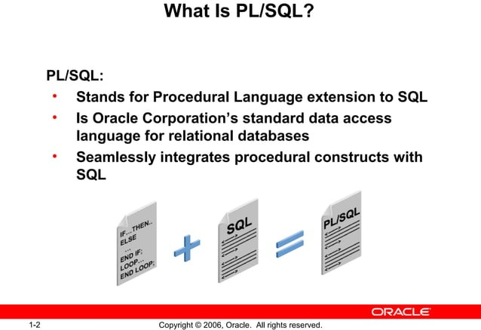

Slide 4
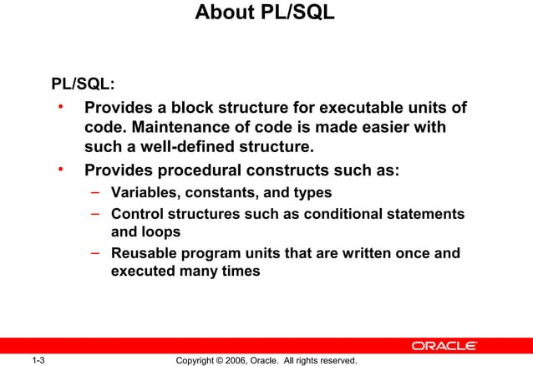

Slide 5
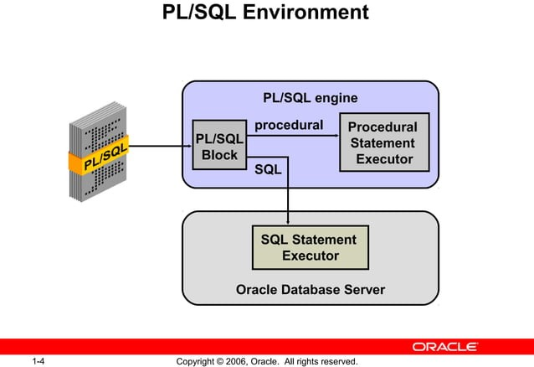

Slide 6
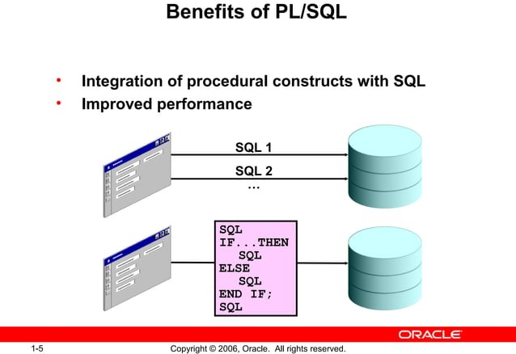

Slide 7
PL/SQL Advantages
Applications written in PL/SQL are fully portable.
PL/SQL provides high security level.
PL/SQL provides access to predefined SQL packages.
PL/SQL provides support for Object-Oriented Programming.
PL/SQL provides support for developing Web Applications and Server Pages.
PL/SQL saves time on design and debugging by strong features, such as exception handling, encapsulation, data hiding, and object-oriented data types.

Slide 8
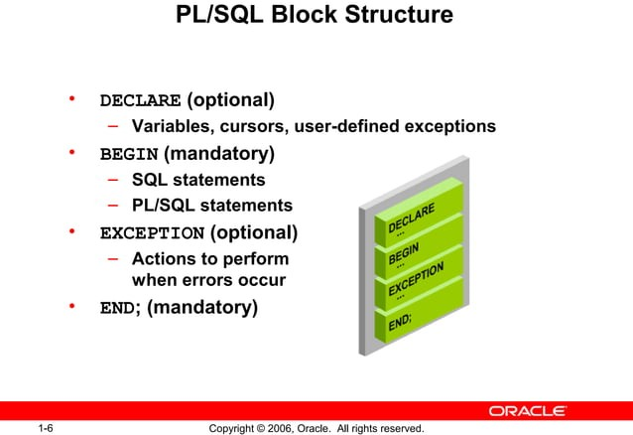

Slide 9
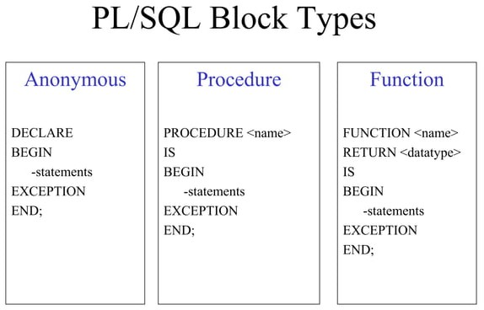

Slide 10
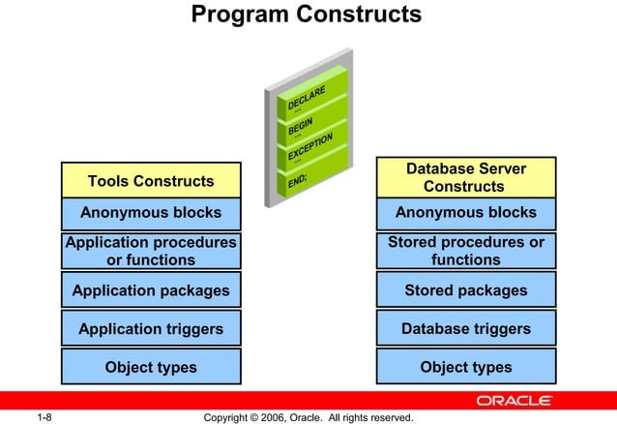

Slide 11
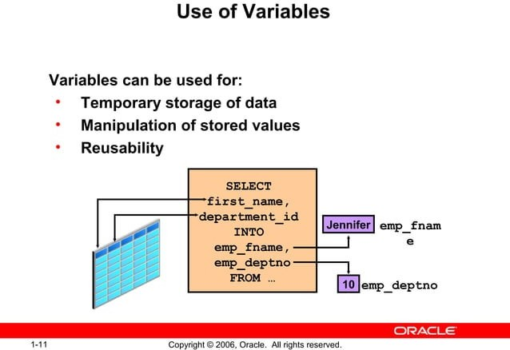

Slide 12
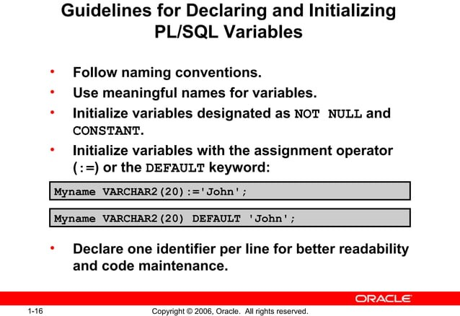

Slide 13
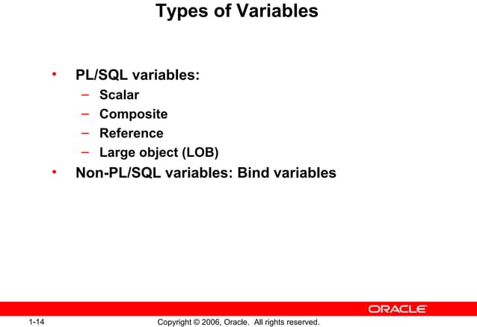

Slide 14
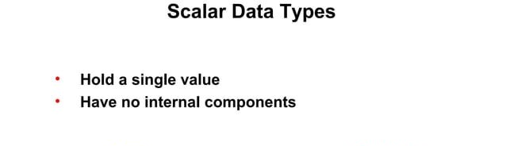

Slide 15
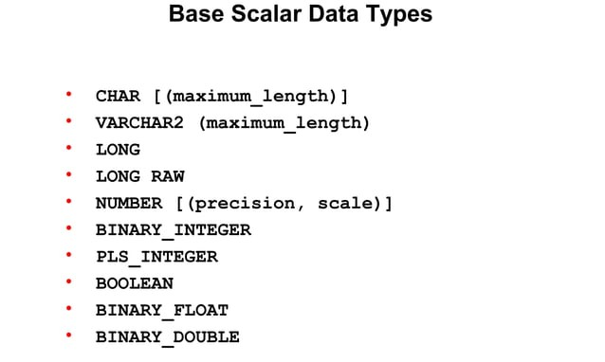

Slide 16
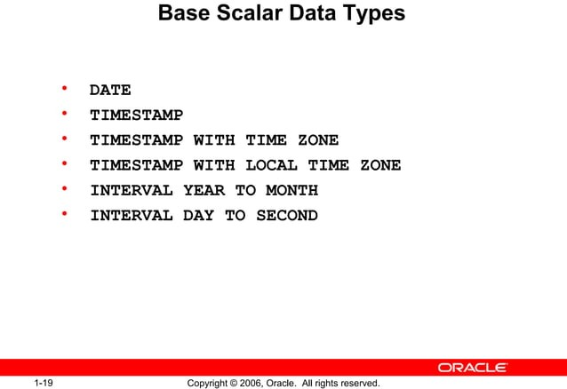

Slide 17
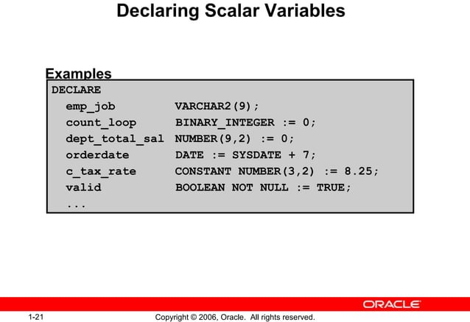

Slide 18
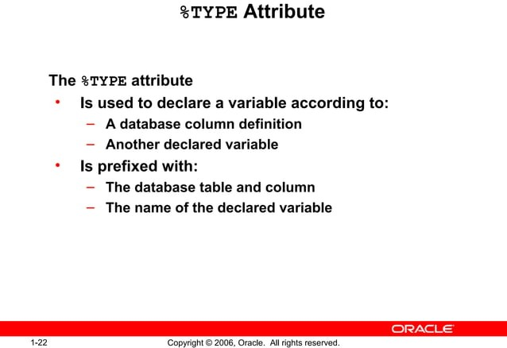

Slide 19
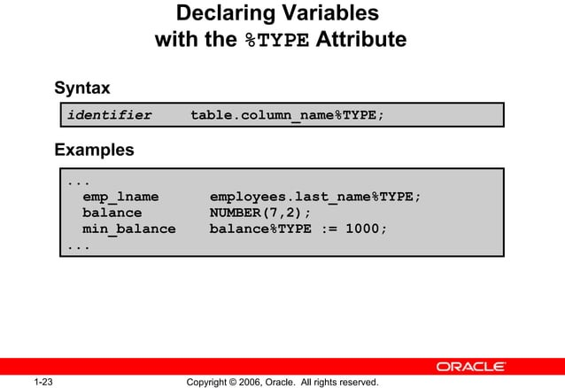

Slide 20
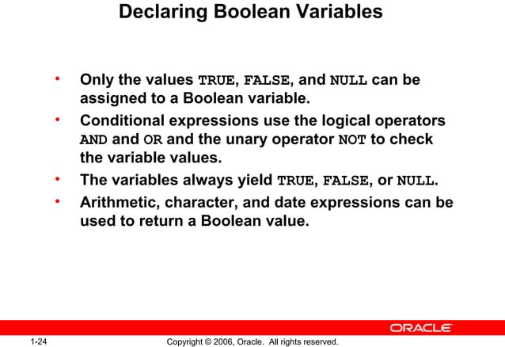

Slide 21
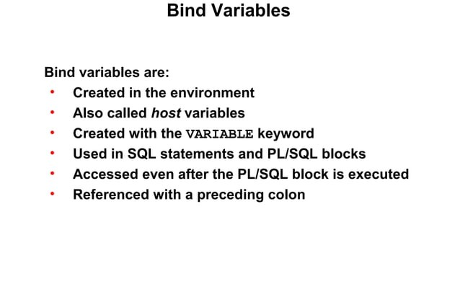

Slide 22
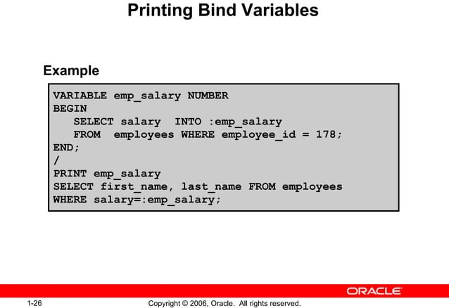

Slide 23
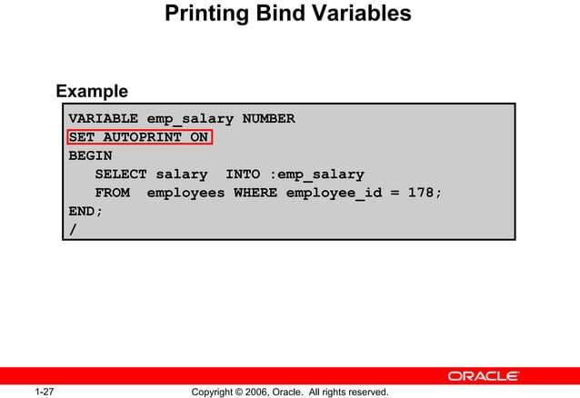

Slide 24
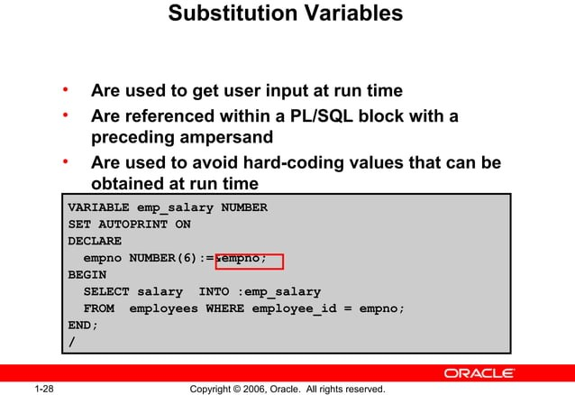

Slide 25
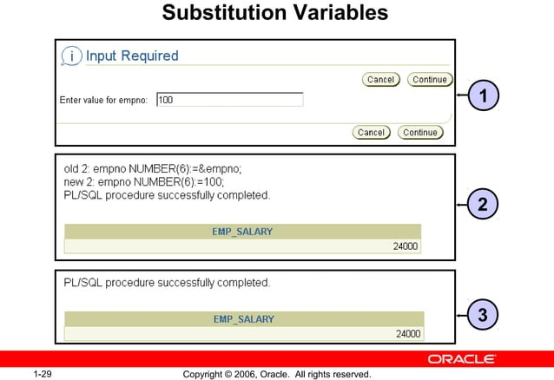

Slide 26
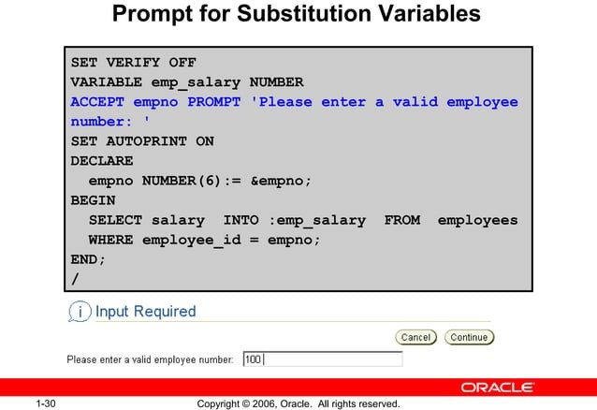

Slide 27
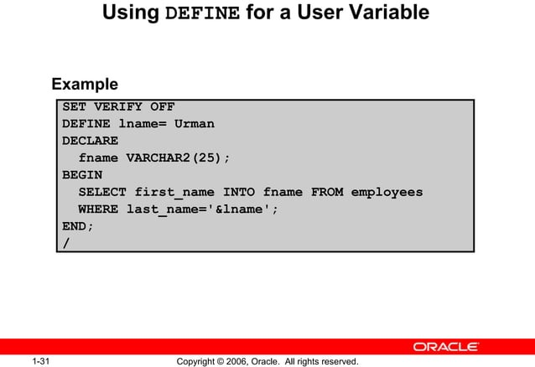

Slide 28
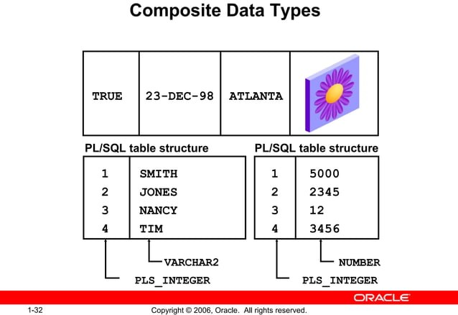

Slide 29
PL/SQL EXIT(LOOP)
DECLARE
VAR1 NUMBER;
VAR2 NUMBER;
BEGIN
VAR1:=100;
VAR2:=1;
LOOP
DBMS_OUTPUT.PUT_LINE (VAR1*VAR2);
IF (VAR2=10) THEN
EXIT;
END IF;
VAR2:=VAR2+1;
END LOOP;
END;
Notes:
When the web was conceived, browsers were limited to text and image - later tables and frames. The extent to which they provided interactivity with the user was very limited. JavaScript was developed by Netscape as a simple programming language (often referred to as a scripting language). It is easy to learn and small sections of JavaScript can be added to a web page rather than needing to develop complicated programs. It was specially designed for web page interaction and manipulating the web browser and page elements. It is often used to respond to user actions such as mouse clicks.
Although developed by Netscape, and other variants exist, such as Jscript from Microsoft, a standard has been developed by the European Computer Manufacturers Association. It is known as ECMAScript, using the standard ECMA262, which can be found fully documented at the address on the slide.

Slide 30
XML
Extensible Markup Language (XML) is a markup language that defines a set of rules for encoding documents in a format that is both human-readable and machine-readable.
to store and transport data and used to carry data not to display data
The design of XML focuses on documents, the language is widely used for the representation of arbitrary data structures such as those used in web services.
<!-- This is a comment -->
Differences between XML and HTML
XML is designed to carry data emphasizing on what type of data it is.
HTML is designed to display data emphasizing on how data looks
XML tags are not predefined like HTML tags.
HTML is a markup language whereas XML provides a framework for defining markup languages.
HTML is about displaying data, hence it is static whereas XML is about carrying information, which makes it dynamic.
Notes:
When the web was conceived, browsers were limited to text and image - later tables and frames. The extent to which they provided interactivity with the user was very limited. JavaScript was developed by Netscape as a simple programming language (often referred to as a scripting language). It is easy to learn and small sections of JavaScript can be added to a web page rather than needing to develop complicated programs. It was specially designed for web page interaction and manipulating the web browser and page elements. It is often used to respond to user actions such as mouse clicks.
Although developed by Netscape, and other variants exist, such as Jscript from Microsoft, a standard has been developed by the European Computer Manufacturers Association. It is known as ECMAScript, using the standard ECMA262, which can be found fully documented at the address on the slide.

Slide 31
XML Syntax
Declaration
<?xml version="1.0" encoding="UTF-8"?>
Each element has a start tag, content, and an end tag.
<elementName>content</elementName>
Nesting
Elements can contain other elements, creating a hierarchical structure.
<parent>
<child>Content</child>
</parent>

Slide 32
XML Syntax
Attributes
Elements can have attributes, which provide additional information about the element.
<elementName attributeName="attributeValue">content</elementName>
Empty Elements
Elements with no content can be written as self-closing tags.
<emptyElement/>

Slide 33
Example
<?xml version="1.1" encoding="UTF-8"?> declaration xml version and character encoding
<library> Root element nested elements
<book id="1"> Attributes uiquely identify each book
<title>IWP</title>
<author>Abhinav</author>
<year>2024</year> Child Elements
<publisher>Spri</publisher>
<isbn>7890</isbn>
</book>
</library>

Slide 34
XML Parser
A parser is a piece of a program that takes a physical representation of data & converts it into memory format.
An xml parser is used to create,read & manipulate an XML document.
Notes:
When the web was conceived, browsers were limited to text and image - later tables and frames. The extent to which they provided interactivity with the user was very limited. JavaScript was developed by Netscape as a simple programming language (often referred to as a scripting language). It is easy to learn and small sections of JavaScript can be added to a web page rather than needing to develop complicated programs. It was specially designed for web page interaction and manipulating the web browser and page elements. It is often used to respond to user actions such as mouse clicks.
Although developed by Netscape, and other variants exist, such as Jscript from Microsoft, a standard has been developed by the European Computer Manufacturers Association. It is known as ECMAScript, using the standard ECMA262, which can be found fully documented at the address on the slide.

Slide 35
XML Parser
The XML (DOM) defines the properties and methods for accessing and editing XML. However, before an XML document can be accessed, it must be loaded into an XML DOM object.
All modern browsers have a built-in XML parser that can convert text into an XML DOM object.
parser = new DOMParser();
xmlDoc = parser.parseFromString(text,"text/xml");
Notes:
When the web was conceived, browsers were limited to text and image - later tables and frames. The extent to which they provided interactivity with the user was very limited. JavaScript was developed by Netscape as a simple programming language (often referred to as a scripting language). It is easy to learn and small sections of JavaScript can be added to a web page rather than needing to develop complicated programs. It was specially designed for web page interaction and manipulating the web browser and page elements. It is often used to respond to user actions such as mouse clicks.
Although developed by Netscape, and other variants exist, such as Jscript from Microsoft, a standard has been developed by the European Computer Manufacturers Association. It is known as ECMAScript, using the standard ECMA262, which can be found fully documented at the address on the slide.

Slide 36
Tree based Parser
This parser transforms the xml document into tree structures and then we can access tree element individually .
Notes:
When the web was conceived, browsers were limited to text and image - later tables and frames. The extent to which they provided interactivity with the user was very limited. JavaScript was developed by Netscape as a simple programming language (often referred to as a scripting language). It is easy to learn and small sections of JavaScript can be added to a web page rather than needing to develop complicated programs. It was specially designed for web page interaction and manipulating the web browser and page elements. It is often used to respond to user actions such as mouse clicks.
Although developed by Netscape, and other variants exist, such as Jscript from Microsoft, a standard has been developed by the European Computer Manufacturers Association. It is known as ECMAScript, using the standard ECMA262, which can be found fully documented at the address on the slide.

Slide 37
Document Object Module Parser
An xml parser only read XML document.
It cannot read documents or create documents so an alternative approach is to use DOM.
DOM CLASS
DOMNODE- Single node in DOM tree.
DOMDocument-stores entire XML docunments in the form of DOM tree.
DOMElements- Represent an element node.
DOMText- Plain text node
DOMCharacterData- character data
$d=new DOMDocument();

Slide 38
XML DOM
The Document Object Model (DOM) defines a standard for accessing and manipulating documents.
The HTML DOM defines a standard way for accessing and manipulating HTML documents. It presents an HTML document as a tree-structure.
The XML DOM defines a standard way for accessing and manipulating XML documents. It presents an XML document as a tree-structure.
Notes:
When the web was conceived, browsers were limited to text and image - later tables and frames. The extent to which they provided interactivity with the user was very limited. JavaScript was developed by Netscape as a simple programming language (often referred to as a scripting language). It is easy to learn and small sections of JavaScript can be added to a web page rather than needing to develop complicated programs. It was specially designed for web page interaction and manipulating the web browser and page elements. It is often used to respond to user actions such as mouse clicks.
Although developed by Netscape, and other variants exist, such as Jscript from Microsoft, a standard has been developed by the European Computer Manufacturers Association. It is known as ECMAScript, using the standard ECMA262, which can be found fully documented at the address on the slide.

Slide 39
HTML DOM XML DOM
<h1 id="demo">This is a Heading</h1>
<button type="button"
onclick="document.getElementById('demo').innerHTML = 'Hello World!'">Click Me!
</button>
<?xml version="1.1" encoding="UTF-8"?>
<Restaurant>
<food category="cooking">
<title lang="en">Everyday Italian</title>
< Chinees >Noodles</ Chinees >
<price>100.00</price>
</ Restaurant >
Notes:
When the web was conceived, browsers were limited to text and image - later tables and frames. The extent to which they provided interactivity with the user was very limited. JavaScript was developed by Netscape as a simple programming language (often referred to as a scripting language). It is easy to learn and small sections of JavaScript can be added to a web page rather than needing to develop complicated programs. It was specially designed for web page interaction and manipulating the web browser and page elements. It is often used to respond to user actions such as mouse clicks.
Although developed by Netscape, and other variants exist, such as Jscript from Microsoft, a standard has been developed by the European Computer Manufacturers Association. It is known as ECMAScript, using the standard ECMA262, which can be found fully documented at the address on the slide.

Slide 40
XML XPath
XPath can be used to navigate through elements and attributes in an XML document.
-XPath is a syntax for defining parts of an XML document
-XPath uses path expressions to navigate in XML documents
-XPath contains a library of standard functions
-XPath is a major element in XSLT and in XQuery
Notes:
When the web was conceived, browsers were limited to text and image - later tables and frames. The extent to which they provided interactivity with the user was very limited. JavaScript was developed by Netscape as a simple programming language (often referred to as a scripting language). It is easy to learn and small sections of JavaScript can be added to a web page rather than needing to develop complicated programs. It was specially designed for web page interaction and manipulating the web browser and page elements. It is often used to respond to user actions such as mouse clicks.
Although developed by Netscape, and other variants exist, such as Jscript from Microsoft, a standard has been developed by the European Computer Manufacturers Association. It is known as ECMAScript, using the standard ECMA262, which can be found fully documented at the address on the slide.

Slide 41
XML XPath
Chrome, Firefox, Edge, Opera, and Safari use the evaluate() method to select nodes:
xmlDoc.evaluate(xpath, xmlDoc, null, XPathResult.ANY_TYPE,null);
Internet Explorer uses the selectNodes() method to select node:
xmlDoc.selectNodes(xpath);
Notes:
When the web was conceived, browsers were limited to text and image - later tables and frames. The extent to which they provided interactivity with the user was very limited. JavaScript was developed by Netscape as a simple programming language (often referred to as a scripting language). It is easy to learn and small sections of JavaScript can be added to a web page rather than needing to develop complicated programs. It was specially designed for web page interaction and manipulating the web browser and page elements. It is often used to respond to user actions such as mouse clicks.
Although developed by Netscape, and other variants exist, such as Jscript from Microsoft, a standard has been developed by the European Computer Manufacturers Association. It is known as ECMAScript, using the standard ECMA262, which can be found fully documented at the address on the slide.

Slide 42
Example
<books>
<book>
<title>Book Title 1</title>
</book>
<book>
<title>Book Title 2</title>
</book></books>
XPath Query:
/books/book/title

Slide 43
XSL/XSLT
XSL (eXtensible Stylesheet Language) is a styling language for XML.
XSLT stands for XSL Transformations. It is a language for transforming XML documents.
The root element that declares the document to be an XSL style sheet is <xsl:stylesheet> or <xsl:transform>.
Notes:
When the web was conceived, browsers were limited to text and image - later tables and frames. The extent to which they provided interactivity with the user was very limited. JavaScript was developed by Netscape as a simple programming language (often referred to as a scripting language). It is easy to learn and small sections of JavaScript can be added to a web page rather than needing to develop complicated programs. It was specially designed for web page interaction and manipulating the web browser and page elements. It is often used to respond to user actions such as mouse clicks.
Although developed by Netscape, and other variants exist, such as Jscript from Microsoft, a standard has been developed by the European Computer Manufacturers Association. It is known as ECMAScript, using the standard ECMA262, which can be found fully documented at the address on the slide.

Slide 44
XSL/XSLT
</tr>
<tr>
<td>1</td>
<td>Priscilla</td>
<td>SCAI</td>
</tr>
</table>
</body>
</html>
</xsl:template>
</xsl:stylesheet>
<xsl:template match="/">
<html>
<body> <h2>University</h2>
<table border="1">
<tr bgcolor="green">
<th>S.No</th>
<th>Name</th>
<th>Department</th>
Notes:
When the web was conceived, browsers were limited to text and image - later tables and frames. The extent to which they provided interactivity with the user was very limited. JavaScript was developed by Netscape as a simple programming language (often referred to as a scripting language). It is easy to learn and small sections of JavaScript can be added to a web page rather than needing to develop complicated programs. It was specially designed for web page interaction and manipulating the web browser and page elements. It is often used to respond to user actions such as mouse clicks.
Although developed by Netscape, and other variants exist, such as Jscript from Microsoft, a standard has been developed by the European Computer Manufacturers Association. It is known as ECMAScript, using the standard ECMA262, which can be found fully documented at the address on the slide.

Slide 45
Xquery
XQuery is a language for finding and extracting elements and attributes from XML documents.
Extract information to use in a Web Service
Generate summary reports
Transform XML data to XHTML
Search Web documents for relevant information
Notes:
When the web was conceived, browsers were limited to text and image - later tables and frames. The extent to which they provided interactivity with the user was very limited. JavaScript was developed by Netscape as a simple programming language (often referred to as a scripting language). It is easy to learn and small sections of JavaScript can be added to a web page rather than needing to develop complicated programs. It was specially designed for web page interaction and manipulating the web browser and page elements. It is often used to respond to user actions such as mouse clicks.
Although developed by Netscape, and other variants exist, such as Jscript from Microsoft, a standard has been developed by the European Computer Manufacturers Association. It is known as ECMAScript, using the standard ECMA262, which can be found fully documented at the address on the slide.

Slide 46
Xquery-Expressions
doc("books.xml")
doc("books.xml")/books/book- Xpath expression
where $x/price>10- Condition
($x represents the selected node, "/" is used to get the value of the required element; "where" clause is used to put a condition on the search results.)
return $x/title
Notes:
When the web was conceived, browsers were limited to text and image - later tables and frames. The extent to which they provided interactivity with the user was very limited. JavaScript was developed by Netscape as a simple programming language (often referred to as a scripting language). It is easy to learn and small sections of JavaScript can be added to a web page rather than needing to develop complicated programs. It was specially designed for web page interaction and manipulating the web browser and page elements. It is often used to respond to user actions such as mouse clicks.
Although developed by Netscape, and other variants exist, such as Jscript from Microsoft, a standard has been developed by the European Computer Manufacturers Association. It is known as ECMAScript, using the standard ECMA262, which can be found fully documented at the address on the slide.

Slide 47
Xquery-Characteristics
Functional Language − XQuery is a language to retrieve/querying XML based data.
Analogous to SQL − XQuery is to XML what SQL is to databases.
XPath based − XQuery uses XPath expressions to navigate through XML documents.
Universally accepted − XQuery is supported by all major databases.
Notes:
When the web was conceived, browsers were limited to text and image - later tables and frames. The extent to which they provided interactivity with the user was very limited. JavaScript was developed by Netscape as a simple programming language (often referred to as a scripting language). It is easy to learn and small sections of JavaScript can be added to a web page rather than needing to develop complicated programs. It was specially designed for web page interaction and manipulating the web browser and page elements. It is often used to respond to user actions such as mouse clicks.
Although developed by Netscape, and other variants exist, such as Jscript from Microsoft, a standard has been developed by the European Computer Manufacturers Association. It is known as ECMAScript, using the standard ECMA262, which can be found fully documented at the address on the slide.

Slide 48
DTD(Document Type Definition)
A DTD defines the structure and the legal elements and attributes of an XML document.
!DOCTYPE note defines that the root element of this document is note
!ELEMENT note defines that the note element must contain four elements: "to, from, heading, body“
Notes:
When the web was conceived, browsers were limited to text and image - later tables and frames. The extent to which they provided interactivity with the user was very limited. JavaScript was developed by Netscape as a simple programming language (often referred to as a scripting language). It is easy to learn and small sections of JavaScript can be added to a web page rather than needing to develop complicated programs. It was specially designed for web page interaction and manipulating the web browser and page elements. It is often used to respond to user actions such as mouse clicks.
Although developed by Netscape, and other variants exist, such as Jscript from Microsoft, a standard has been developed by the European Computer Manufacturers Association. It is known as ECMAScript, using the standard ECMA262, which can be found fully documented at the address on the slide.

Slide 49
DTD(Document Type Definition)
All XML documents are made up by the following
Elements-Elements are the main building blocks of both XML and HTML documents.
Attributes- Attributes provide extra information about elements.
Entities- Some characters have a special meaning in XML, like the less than sign (<) that defines the start of an XML tag.
PCDATA- PCDATA means parsed character data.
PCDATA is text that WILL be parsed by a parser. The text will be examined by the parser for entities and markup.
CDATA- DATA means character data.
CDATA is text that will NOT be parsed by a parser. Tags inside the text will NOT be treated as markup and entities will not be expanded.
Notes:
When the web was conceived, browsers were limited to text and image - later tables and frames. The extent to which they provided interactivity with the user was very limited. JavaScript was developed by Netscape as a simple programming language (often referred to as a scripting language). It is easy to learn and small sections of JavaScript can be added to a web page rather than needing to develop complicated programs. It was specially designed for web page interaction and manipulating the web browser and page elements. It is often used to respond to user actions such as mouse clicks.
Although developed by Netscape, and other variants exist, such as Jscript from Microsoft, a standard has been developed by the European Computer Manufacturers Association. It is known as ECMAScript, using the standard ECMA262, which can be found fully documented at the address on the slide.

Slide 50
DTD(Document Type Definition)
<!DOCTYPE NEWSPAPER [
<!ELEMENT NEWSPAPER (ARTICLE+)>
<!ELEMENT ARTICLE (HEADLINE,BYLINE,LEAD,BODY,NOTES)>
<!ELEMENT HEADLINE (#PCDATA)>
<!ELEMENT BYLINE (#PCDATA)>
<!ELEMENT LEAD (#PCDATA)>
<!ELEMENT BODY (#PCDATA)>
<!ELEMENT NOTES (#PCDATA)>
<!ATTLIST ARTICLE AUTHOR CDATA #REQUIRED>
<!ATTLIST ARTICLE EDITOR CDATA #IMPLIED>
<!ATTLIST ARTICLE DATE CDATA #IMPLIED>
<!ATTLIST ARTICLE EDITION CDATA #IMPLIED>
<!ENTITY NEWSPAPER "Vervet Logic Times">
<!ENTITY PUBLISHER "Vervet Logic Press">
<!ENTITY COPYRIGHT "Copyright 1998 Vervet Logic Press">
]>
Notes:
When the web was conceived, browsers were limited to text and image - later tables and frames. The extent to which they provided interactivity with the user was very limited. JavaScript was developed by Netscape as a simple programming language (often referred to as a scripting language). It is easy to learn and small sections of JavaScript can be added to a web page rather than needing to develop complicated programs. It was specially designed for web page interaction and manipulating the web browser and page elements. It is often used to respond to user actions such as mouse clicks.
Although developed by Netscape, and other variants exist, such as Jscript from Microsoft, a standard has been developed by the European Computer Manufacturers Association. It is known as ECMAScript, using the standard ECMA262, which can be found fully documented at the address on the slide.

Slide 51
XML Schema
An XML Schema describes the structure of an XML document, just like a DTD.
An XML document with correct syntax is called "Well Formed".
An XML document validated against an XML Schema is both "Well Formed" and "Valid".
Notes:
When the web was conceived, browsers were limited to text and image - later tables and frames. The extent to which they provided interactivity with the user was very limited. JavaScript was developed by Netscape as a simple programming language (often referred to as a scripting language). It is easy to learn and small sections of JavaScript can be added to a web page rather than needing to develop complicated programs. It was specially designed for web page interaction and manipulating the web browser and page elements. It is often used to respond to user actions such as mouse clicks.
Although developed by Netscape, and other variants exist, such as Jscript from Microsoft, a standard has been developed by the European Computer Manufacturers Association. It is known as ECMAScript, using the standard ECMA262, which can be found fully documented at the address on the slide.

Slide 52
XML Schema
XML Schema is an XML-based alternative to DTD:
<xs:element name="note">
<xs:complexType>
<xs:sequence>
<xs:element name="to" type="xs:string"/>
<xs:element name="from" type="xs:string"/>
<xs:element name="heading" type="xs:string"/>
<xs:element name="body" type="xs:string"/>
</xs:sequence>
</xs:complexType>
</xs:element>
<xs:element name="note"> defines the element called "note"
<xs:complexType> the "note" element is a complex type
<xs:sequence> the complex type is a sequence of elements
<xs:element name="to" type="xs:string"> the element "to" is of type string (text)
<xs:element name="from" type="xs:string"> the element "from" is of type string
<xs:element name="heading" type="xs:string"> the element "heading" is of type string
<xs:element name="body" type="xs:string"> the element "body" is of type string
Notes:
When the web was conceived, browsers were limited to text and image - later tables and frames. The extent to which they provided interactivity with the user was very limited. JavaScript was developed by Netscape as a simple programming language (often referred to as a scripting language). It is easy to learn and small sections of JavaScript can be added to a web page rather than needing to develop complicated programs. It was specially designed for web page interaction and manipulating the web browser and page elements. It is often used to respond to user actions such as mouse clicks.
Although developed by Netscape, and other variants exist, such as Jscript from Microsoft, a standard has been developed by the European Computer Manufacturers Association. It is known as ECMAScript, using the standard ECMA262, which can be found fully documented at the address on the slide.

Slide 53
XML Schema
XML Schemas are More Powerful than DTD
  XML Schemas are written in XML
  XML Schemas are extensible to additions
  XML Schemas support data types
  XML Schemas support namespaces
Notes:
When the web was conceived, browsers were limited to text and image - later tables and frames. The extent to which they provided interactivity with the user was very limited. JavaScript was developed by Netscape as a simple programming language (often referred to as a scripting language). It is easy to learn and small sections of JavaScript can be added to a web page rather than needing to develop complicated programs. It was specially designed for web page interaction and manipulating the web browser and page elements. It is often used to respond to user actions such as mouse clicks.
Although developed by Netscape, and other variants exist, such as Jscript from Microsoft, a standard has been developed by the European Computer Manufacturers Association. It is known as ECMAScript, using the standard ECMA262, which can be found fully documented at the address on the slide.

Slide 54
XML Schema
One of the greatest strengths of XML Schemas is the support for data types:
  It is easier to describe document content
  It is easier to define restrictions on data
  It is easier to validate the correctness of data
  It is easier to convert data between different data types
Notes:
When the web was conceived, browsers were limited to text and image - later tables and frames. The extent to which they provided interactivity with the user was very limited. JavaScript was developed by Netscape as a simple programming language (often referred to as a scripting language). It is easy to learn and small sections of JavaScript can be added to a web page rather than needing to develop complicated programs. It was specially designed for web page interaction and manipulating the web browser and page elements. It is often used to respond to user actions such as mouse clicks.
Although developed by Netscape, and other variants exist, such as Jscript from Microsoft, a standard has been developed by the European Computer Manufacturers Association. It is known as ECMAScript, using the standard ECMA262, which can be found fully documented at the address on the slide.

Slide 55
XML Schema
Another great strength about XML Schemas is that they are written in XML:
  You don't have to learn a new language
  You can use your XML editor to edit your Schema files
  You can use your XML parser to parse your Schema files
  You can manipulate your Schemas with the XML DOM
  You can transform your Schemas with XSLT
Notes:
When the web was conceived, browsers were limited to text and image - later tables and frames. The extent to which they provided interactivity with the user was very limited. JavaScript was developed by Netscape as a simple programming language (often referred to as a scripting language). It is easy to learn and small sections of JavaScript can be added to a web page rather than needing to develop complicated programs. It was specially designed for web page interaction and manipulating the web browser and page elements. It is often used to respond to user actions such as mouse clicks.
Although developed by Netscape, and other variants exist, such as Jscript from Microsoft, a standard has been developed by the European Computer Manufacturers Association. It is known as ECMAScript, using the standard ECMA262, which can be found fully documented at the address on the slide.

Slide 56
XML Namespaces
XML Namespaces provide a method to avoid element name conflicts.
In XML, element names are defined by the developer. This often results in a conflict when trying to mix XML documents from different XML applications.
Notes:
When the web was conceived, browsers were limited to text and image - later tables and frames. The extent to which they provided interactivity with the user was very limited. JavaScript was developed by Netscape as a simple programming language (often referred to as a scripting language). It is easy to learn and small sections of JavaScript can be added to a web page rather than needing to develop complicated programs. It was specially designed for web page interaction and manipulating the web browser and page elements. It is often used to respond to user actions such as mouse clicks.
Although developed by Netscape, and other variants exist, such as Jscript from Microsoft, a standard has been developed by the European Computer Manufacturers Association. It is known as ECMAScript, using the standard ECMA262, which can be found fully documented at the address on the slide.

Slide 57
XML Namespaces
This XML carries HTML table information:
This XML carries information about a table (a piece of furniture):
<table>
<tr>
<td>Apples</td>
<td>Bananas</td>
</tr>
</table>
<table>
<name>African Coffee Table</name>
<width>80</width>
<length>120</length>
</table>
If these XML fragments were added together, there would be a name conflict. Both contain a <table> element, but the elements have different content and meaning.
A user or an XML application will not know how to handle these differences.
Notes:
When the web was conceived, browsers were limited to text and image - later tables and frames. The extent to which they provided interactivity with the user was very limited. JavaScript was developed by Netscape as a simple programming language (often referred to as a scripting language). It is easy to learn and small sections of JavaScript can be added to a web page rather than needing to develop complicated programs. It was specially designed for web page interaction and manipulating the web browser and page elements. It is often used to respond to user actions such as mouse clicks.
Although developed by Netscape, and other variants exist, such as Jscript from Microsoft, a standard has been developed by the European Computer Manufacturers Association. It is known as ECMAScript, using the standard ECMA262, which can be found fully documented at the address on the slide.

Slide 58
XML Namespaces
Solving the Name Conflict Using a Prefix
<h:table>
<h:tr>
<h:td>Apples</h:td>
<h:td>Bananas</h:td>
</h:tr>
</h:table>
<f:table>
<f:name>African Coffee Table</f:name>
<f:width>80</f:width>
<f:length>120</f:length>
</f:table>
Notes:
When the web was conceived, browsers were limited to text and image - later tables and frames. The extent to which they provided interactivity with the user was very limited. JavaScript was developed by Netscape as a simple programming language (often referred to as a scripting language). It is easy to learn and small sections of JavaScript can be added to a web page rather than needing to develop complicated programs. It was specially designed for web page interaction and manipulating the web browser and page elements. It is often used to respond to user actions such as mouse clicks.
Although developed by Netscape, and other variants exist, such as Jscript from Microsoft, a standard has been developed by the European Computer Manufacturers Association. It is known as ECMAScript, using the standard ECMA262, which can be found fully documented at the address on the slide.

Slide 59
XML Namespaces
XML Namespaces - The xmlns Attribute
When using prefixes in XML, a namespace for the prefix must be defined.
The namespace can be defined by an xmlns attribute in the start tag of an element.
The namespace declaration has the following syntax. xmlns:prefix="URI".
Notes:
When the web was conceived, browsers were limited to text and image - later tables and frames. The extent to which they provided interactivity with the user was very limited. JavaScript was developed by Netscape as a simple programming language (often referred to as a scripting language). It is easy to learn and small sections of JavaScript can be added to a web page rather than needing to develop complicated programs. It was specially designed for web page interaction and manipulating the web browser and page elements. It is often used to respond to user actions such as mouse clicks.
Although developed by Netscape, and other variants exist, such as Jscript from Microsoft, a standard has been developed by the European Computer Manufacturers Association. It is known as ECMAScript, using the standard ECMA262, which can be found fully documented at the address on the slide.

Slide 60
XML Namespaces
<root>
<h:table xmlns:h="http://www.w3.org/TR/html4/">
<h:tr>
<h:td>Apples</h:td>
<h:td>Bananas</h:td>
</h:tr>
</h:table>
<f:table xmlns:f="https://www.w3schools.com/furniture">
<f:name>African Coffee Table</f:name>
<f:width>80</f:width>
<f:length>120</f:length>
</f:table>
</root>
Notes:
When the web was conceived, browsers were limited to text and image - later tables and frames. The extent to which they provided interactivity with the user was very limited. JavaScript was developed by Netscape as a simple programming language (often referred to as a scripting language). It is easy to learn and small sections of JavaScript can be added to a web page rather than needing to develop complicated programs. It was specially designed for web page interaction and manipulating the web browser and page elements. It is often used to respond to user actions such as mouse clicks.
Although developed by Netscape, and other variants exist, such as Jscript from Microsoft, a standard has been developed by the European Computer Manufacturers Association. It is known as ECMAScript, using the standard ECMA262, which can be found fully documented at the address on the slide.

Slide 61
XML Namespaces
Namespaces can also be declared in the XML root element:
<root xmlns:h="http://www.w3.org/TR/html4/"
xmlns:f="https://www.w3schools.com/furniture">
<h:table>
<h:tr>
<h:td>Apples</h:td>
<h:td>Bananas</h:td>
</h:tr>
</h:table>
<f:table>
<f:name>African Coffee Table</f:name>
<f:width>80</f:width>
<f:length>120</f:length>
</f:table>
</root>
Notes:
When the web was conceived, browsers were limited to text and image - later tables and frames. The extent to which they provided interactivity with the user was very limited. JavaScript was developed by Netscape as a simple programming language (often referred to as a scripting language). It is easy to learn and small sections of JavaScript can be added to a web page rather than needing to develop complicated programs. It was specially designed for web page interaction and manipulating the web browser and page elements. It is often used to respond to user actions such as mouse clicks.
Although developed by Netscape, and other variants exist, such as Jscript from Microsoft, a standard has been developed by the European Computer Manufacturers Association. It is known as ECMAScript, using the standard ECMA262, which can be found fully documented at the address on the slide.

Slide 62
XML Namespaces
Uniform Resource Identifier (URI)
A Uniform Resource Identifier (URI) is a string of characters which identifies an Internet Resource.
The most common URI is the Uniform Resource Locator (URL) which identifies an Internet domain address. Another, not so common type of URI is the Uniform Resource Name (URN).
Notes:
When the web was conceived, browsers were limited to text and image - later tables and frames. The extent to which they provided interactivity with the user was very limited. JavaScript was developed by Netscape as a simple programming language (often referred to as a scripting language). It is easy to learn and small sections of JavaScript can be added to a web page rather than needing to develop complicated programs. It was specially designed for web page interaction and manipulating the web browser and page elements. It is often used to respond to user actions such as mouse clicks.
Although developed by Netscape, and other variants exist, such as Jscript from Microsoft, a standard has been developed by the European Computer Manufacturers Association. It is known as ECMAScript, using the standard ECMA262, which can be found fully documented at the address on the slide.

Slide 63
AJAX

Slide 64
What is AJAX
AJAX is an acronym for Asynchronous JavaScript and XML. It is a group of inter-related technologies like JavaScript, DOM, XML, HTML/ XHTML, CSS, XMLHttpRequest etc.
AJAX allows you to send and receive data asynchronously without reloading the web page. So, it is fast.
AJAX allows you to send only important information to the server not the entire page. So only valuable data from the client side is routed to the server side. It makes your application interactive and faster.
Where it is used?
There are too many web applications running on the web that are using ajax technology like gmail, facebook, twitter, google map, youtube etc.

Slide 65
Famous web applications that make use of AJAX
Google Maps: A user can drag an entire map by using the mouse, rather than clicking on a button.
Google Suggest: As you type, Google offers suggestions. Use the arrow keys to navigate the results.
Gmail: Gmail is a webmail built on the idea that emails can be more intuitive, efficient, and useful.
Yahoo Maps (new): Now it's even easier and more fun to get where you're going!

Slide 66
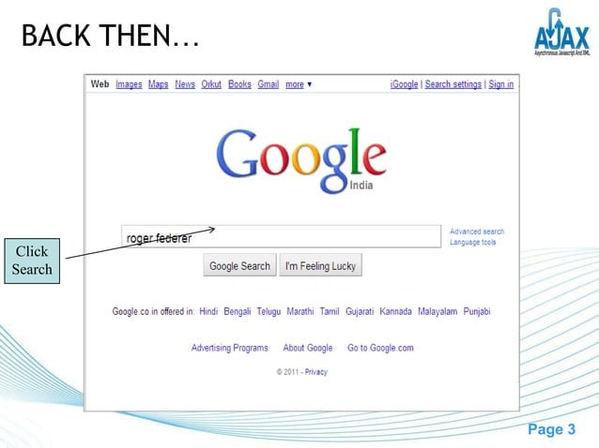

Slide 67
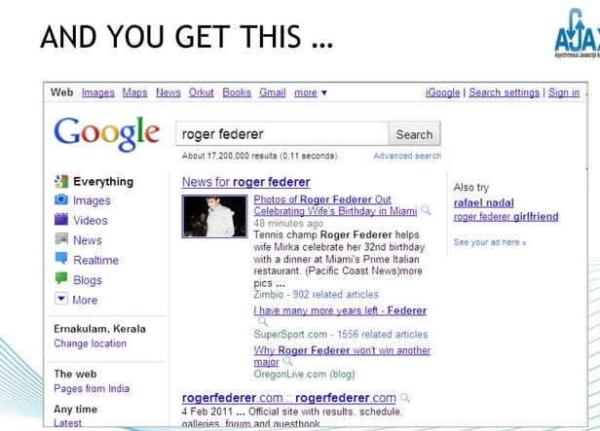

Slide 68
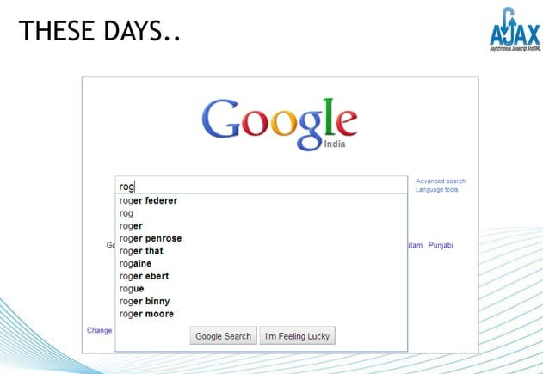

Slide 69
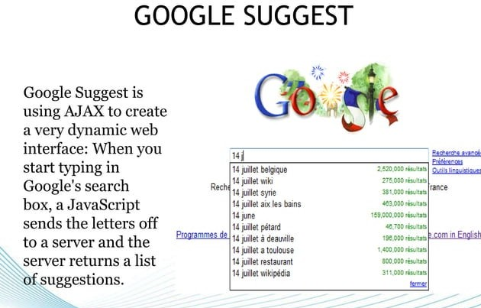

Slide 70
AJAX Technologies
As describe earlier, Ajax is not a technology but group of inter-related technologies. AJAX technologies includes:
HTML/XHTML and CSS-These technologies are used for displaying content and style. It is mainly used for presentation.
DOM- It is used for dynamic display and interaction with data.
XML or JSON- For carrying data to and from server. JSON (Javascript Object Notation) is like XML but short and faster than XML.
XMLHttpRequest- For asynchronous communication between client and server.
JavaScript- It is used to bring above technologies together. Independently, it is used mainly for client-side validation.

Slide 71
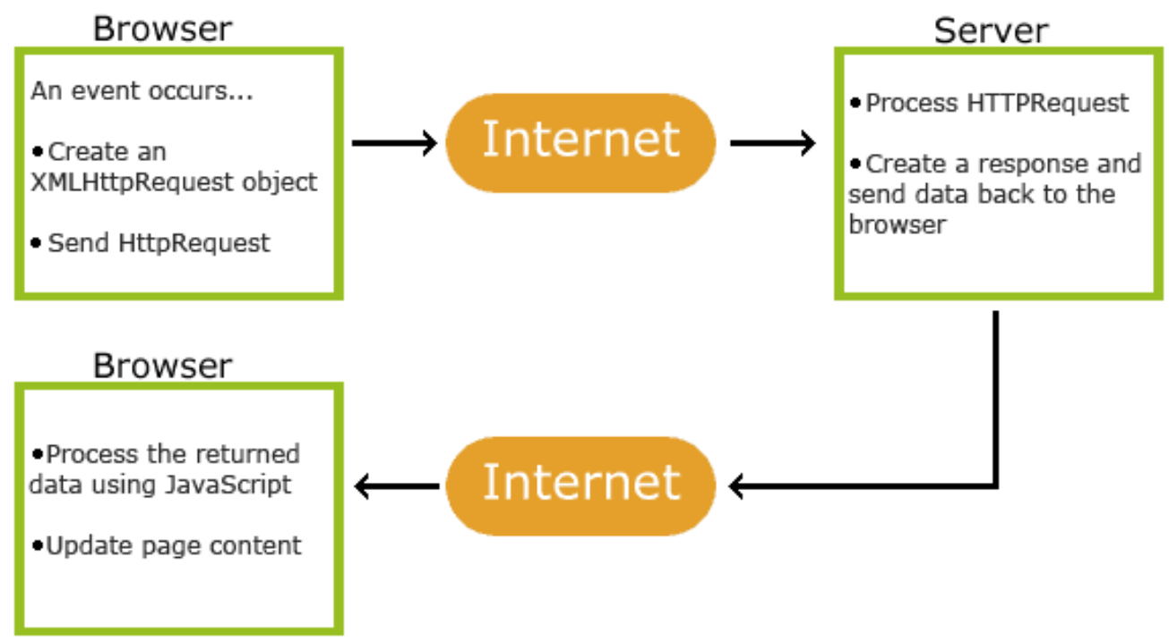
How AJAX Works
1. An event occurs in a web page (the page is loaded, a button is clicked)
2. An XMLHttpRequest object is created by JavaScript
3. The XMLHttpRequest object sends a request to a web server
4. The server processes the request
5. The server sends a response back to the web page
6. The response is read by JavaScript
7. Proper action (like page update) is performed by JavaScript

Slide 72
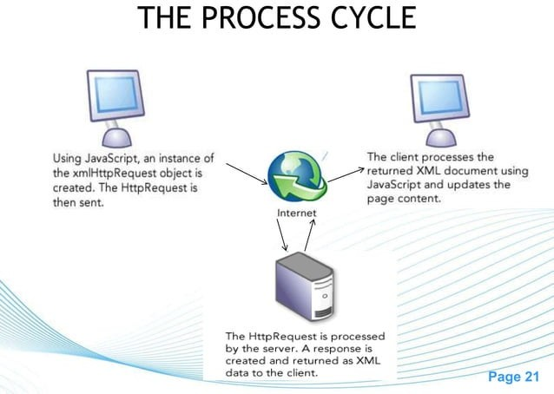
How AJAX Works

Slide 73
How AJAX Works
Update a web page without reloading the page
Request data from a server - after the page has loaded
Receive data from a server - after the page has loaded
Send data to a server - in the background

Slide 74
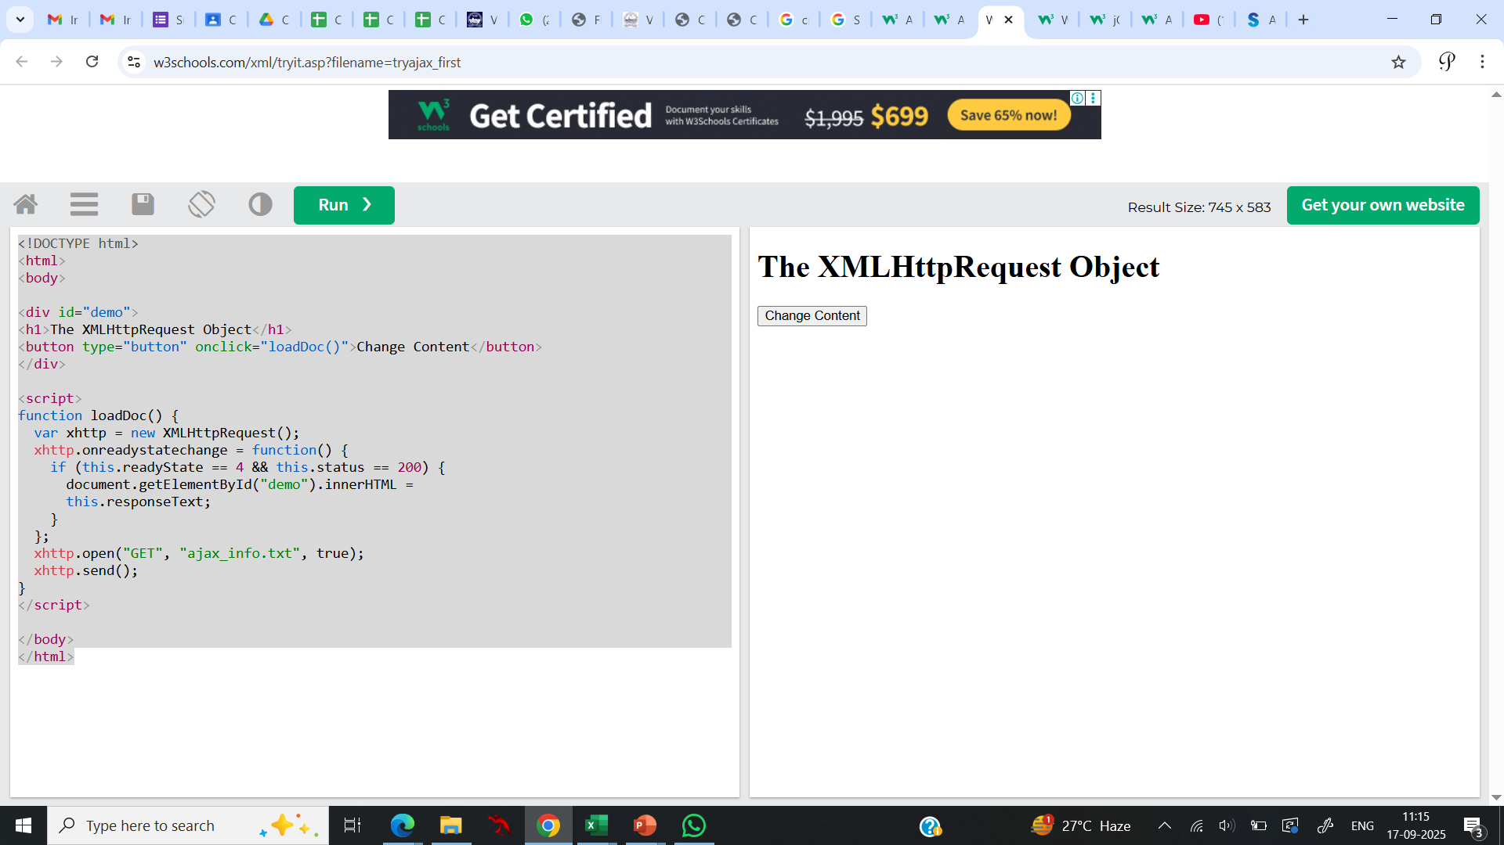
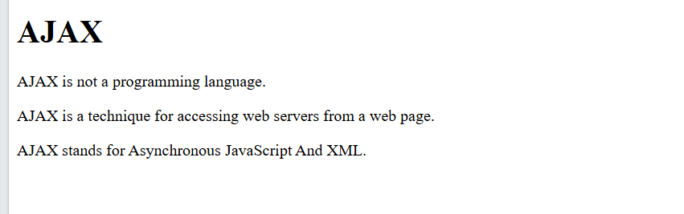
How AJAX Works
The HTML page contains a <div> section and a <button>.
The <div> section is used to display information from a server.
The <button> calls a function (if it is clicked).
The function requests data from a web server and displays it:
<!DOCTYPE html>
<html>
<body>
<div id="demo">
<h1>The XMLHttpRequest Object</h1>
<button type="button" onclick="loadDoc()">Change Content</button>
</div>
<script>
function loadDoc() {
var xhttp = new XMLHttpRequest();
xhttp.onreadystatechange = function() {
if (this.readyState == 4 && this.status == 200) {
document.getElementById("demo").innerHTML =
this.responseText;
}
};
xhttp.open("GET", "ajax_info.txt", true);
xhttp.send();
}
</script>
</body>
</html>
Result

Slide 75
XMLHttpRequest Object
Understanding XMLHttpRequest
An object of XMLHttpRequest is used for asynchronous communication between client and server.
It performs following operations:
Sends data from the client in the background
Receives the data from the server
Updates the webpage without reloading it.

Slide 76
XMLHttpRequest Object Methods
Method | Description
new XMLHttpRequest() | Creates a new XMLHttpRequest object
abort() | Cancels the current request
getAllResponseHeaders() | Returns header information
getResponseHeader() | Returns specific header information
open(method,url,async,user,psw) | Specifies the request method: the request type GET or POST url: the file location async: true (asynchronous) or false (synchronous) user: optional user name psw: optional password
send() | Sends the request to the server Used for GET requests
send(string) | Sends the request to the server. Used for POST requests
setRequestHeader() | Adds a label/value pair to the header to be sent

Slide 77
XMLHttpRequest Object Properties
Property | Description
onreadystatechange | Defines a function to be called when the readyState property changes
readyState | Holds the status of the XMLHttpRequest. 0: request not initialized 1: server connection established 2: request received 3: processing request 4: request finished and response is ready
responseText | Returns the response data as a string
responseXML | Returns the response data as XML data
status | Returns the status-number of a request 200: "OK" 403: "Forbidden" 404: "Not Found" For a complete list go to the Http Messages Reference

Slide 78
AJAX Request
The XMLHttpRequest object is used to exchange data with a server.
To send a request to a server, we use the open() and send() methods of the XMLHttpRequest object.
Ex:
xhttp.open("GET", "ajax_info.txt", true);
xhttp.send();
Method | Description
open(method, url, async) | Specifies the type of request method: the type of request: GET or POST url: the server (file) location async: true (asynchronous) or false (synchronous)
send() | Sends the request to the server (used for GET)
send(string) | Sends the request to the server (used for POST)

Slide 79
AJAX Request
GET or POST?
GET is simpler and faster than POST, and can be used in most cases.
However, always use POST requests when:
  A cached file is not an option (update a file or database on the server).
  Sending a large amount of data to the server (POST has no size limitations).
  Sending user input (which can contain unknown characters), POST is more robust and secure than GET.

Slide 80
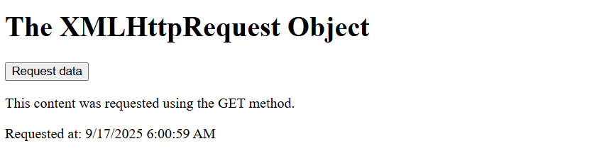
AJAX Request
Ex: A simple GET request:
In the example above, you may get a cached result. To avoid this, add a unique ID to the URL .
To send information with the GET method, add the information to the URL
xhttp.open("GET", "demo_get.asp", true);
xhttp.send();
xhttp.open("GET", "demo_get.asp?t=" + Math.random(), true);
xhttp.send();
xhttp.open("GET", "demo_get2.asp?fname=Henry&lname=Ford", true);
xhttp.send();

Slide 81
AJAX Response
The readyState property holds the status of the XMLHttpRequest.
The onreadystatechange property defines a function to be executed when the readyState changes.
The status property and the statusText property holds the status of the XMLHttpRequest object.

Slide 82
AJAX Response
Property | Description
onreadystatechange | Defines a function to be called when the readyState property changes
readyState | Holds the status of the XMLHttpRequest. 0: request not initialized 1: server connection established 2: request received 3: processing request 4: request finished and response is ready
status | 200: "OK" 403: "Forbidden" 404: "Page not found" For a complete list go to the Http Messages Reference

Slide 83
AJAX Response
<script>
function loadDoc() {
var xhttp = new XMLHttpRequest();
xhttp.onreadystatechange = function() {
if (this.readyState == 4 && this.status == 200) {
document.getElementById("demo").innerHTML =
this.responseText;
}
};
xhttp.open("GET", "ajax_info.txt", true);
xhttp.send();
}
</script>
The onreadystatechange function is called every time the readyState changes.
When readyState is 4 and status is 200, the response is ready:

Slide 84
AJAX using XML
AJAX can be used for interactive communication with an XML file.
function myFunction(xml) {
var i;
var xmlDoc = xml.responseXML;
var table="<tr><th>Artist</th><th>Title</th></tr>";
var x = xmlDoc.getElementsByTagName("CD");
for (i = 0; i <x.length; i++) {
table += "<tr><td>" +
x[i].getElementsByTagName("ARTIST")[0].childNodes[0].nodeValue +
"</td><td>" +
x[i].getElementsByTagName("TITLE")[0].childNodes[0].nodeValue +
"</td></tr>";
}
document.getElementById("demo").innerHTML = table;
}
</script>
</body>
</html>
<!DOCTYPE html>
<html>
<style>
table,th,td {
border : 1px solid black;
border-collapse: collapse;
}
th,td {
padding: 5px;
}
</style>
<body>
<h1>The XMLHttpRequest Object</h1>
<button type="button" onclick="loadDoc()">Get my CD collection</button>
<br><br>
<table id="demo"></table>
<script>
function loadDoc() {
var xhttp = new XMLHttpRequest();
xhttp.onreadystatechange = function() {
if (this.readyState == 4 && this.status == 200) {
myFunction(this);
}
};
xhttp.open("GET", "cd_catalog.xml", true);
xhttp.send();
}

Slide 85
AJAX using XML
For the previous example,
When a user clicks on the "Get CD info" button above, the loadDoc() function is executed.
The loadDoc() function creates an XMLHttpRequest object, adds the function to be executed when the server response is ready, and sends the request off to the server.
When the server response is ready, an HTML table is built, nodes (elements) are extracted from the XML file, and it finally updates the element "demo" with the HTML table filled with XML data:

Slide 86
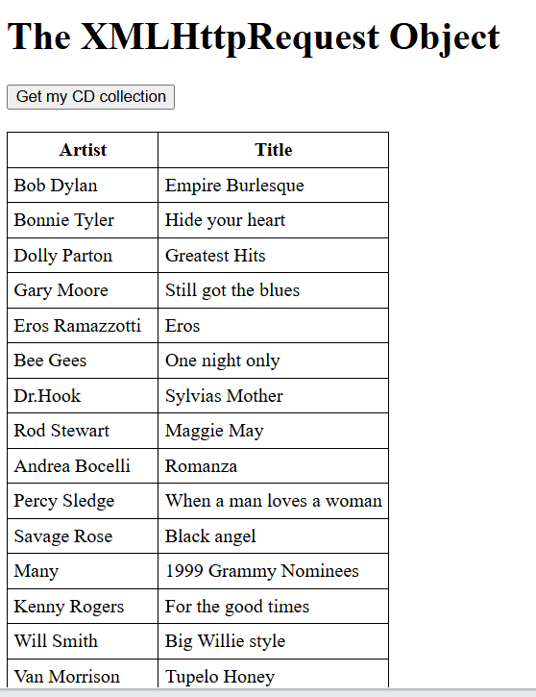
AJAX using XML
For the previous example, Result:

Slide 87
AJAX using Javascript and JQuery
jQuery provides several methods for AJAX functionality.
With the jQuery AJAX methods, you can request text, HTML, XML, or JSON from a remote server using both HTTP Get and HTTP Post - And you can load the external data directly into the selected HTML elements of your web page!

Slide 88
AJAX using Javascript and JQuery
jQuery - AJAX load() Method
The jQuery load() method is a simple, but powerful AJAX method.
The load() method loads data from a server and puts the returned data into the selected element.
Syntax:
$(selector).load(URL,data,callback);
  The required URL parameter specifies the URL you wish to load.
  The optional data parameter specifies a set of querystring key/value pairs to send along with the request.
  The optional callback parameter is the name of a function to be executed after the load() method is completed.

Slide 89
AJAX using Javascript and JQuery
example loads the content of the file "demo_test.txt" into a specific <div> element:
$("#div1").load("demo_test.txt");
The optional callback parameter specifies a callback function to run when the load() method is completed. The callback function can have different parameters:
  responseTxt - contains the resulting content if the call succeeds
  statusTxt - contains the status of the call
  xhr - contains the XMLHttpRequest object

Slide 90
AJAX using Javascript and JQuery
Example displays an alert box after the load() method completes. If the load() method has succeeded, it displays "External content loaded successfully!", and if it fails it displays an error message:
$("button").click(function(){
$("#div1").load("demo_test.txt", function(responseTxt, statusTxt, xhr){
if(statusTxt == "success")
alert("External content loaded successfully!");
if(statusTxt == "error")
alert("Error: " + xhr.status + ": " + xhr.statusText);
});
});

Slide 91
AJAX using Javascript and JQuery
jQuery - AJAX get() and post() Methods
Two commonly used methods for a request-response between a client and server are: GET and POST.
  GET - Requests data from a specified resource
  POST - Submits data to be processed to a specified resource
GET is basically used for just getting (retrieving) some data from the server.
POST can also be used to get some data from the server. However, the POST method NEVER caches data, and is often used to send data along with the request.
Note: The GET method may return cached data.

Slide 92
AJAX using Javascript and JQuery
jQuery - AJAX get() and post() Methods
1. jQuery $.get() Method
The $.get() method requests data from the server with an HTTP GET request.
Syntax: $.get(URL,callback);
The required URL parameter specifies the URL you wish to request.
The optional callback parameter is the name of a function to be executed if the request succeeds.

Slide 93
AJAX using Javascript and JQuery
jQuery - AJAX get() and post() Methods
1. jQuery $.get() Method
Ex:
$("button").click(function(){
$.get("demo_test.asp", function(data, status){
alert("Data: " + data + "\nStatus: " + status);
});
});
The first parameter of $.get() is the URL wish to request ("demo_test.asp").
The second parameter is a callback function. The first callback parameter holds the content of the page requested, and the second callback parameter holds the status of the request.

Slide 94
AJAX using Javascript and JQuery
jQuery - AJAX get() and post() Methods
2. jQuery $.post() Method
The $.post() method requests data from the server using an HTTP POST request.
Syntax: $.post(URL,data,callback);
The required URL parameter specifies the URL you wish to request.
The optional data parameter specifies some data to send along with the request.
The optional callback parameter is the name of a function to be executed if the request succeeds.

Slide 95
AJAX using Javascript and JQuery
jQuery - AJAX get() and post() Methods
2. jQuery $.post() Method
Ex:
$("button").click(function(){
$.post("demo_test_post.asp",
{
name: "Donald Duck",
city: "Duckburg"
},
function(data, status){
alert("Data: " + data + "\nStatus: " + status);
});
});
The first parameter of $.post() is the URL we wish to request ("demo_test_post.asp").
Then we pass in some data to send along with the request (name and city).
The ASP script in "demo_test_post.asp" reads the parameters, processes them, and returns a result.
The third parameter is a callback function. The first callback parameter holds the content of the page requested, and the second callback parameter holds the status of the request.

Slide 96
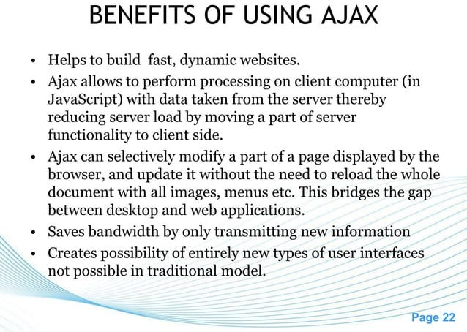

Slide 97
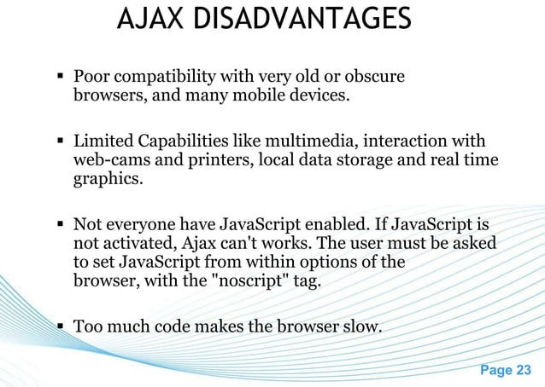

Slide 98
